Slide 1
Entity Relationship Diagram
Relationships

Slide 2
Reading
Chapter 7: “Data Modelling Using the Entity Relationship Model”
Book: Fundamentals of Database System – 6th Edition by Elmasri

Slide 3
Example: COMPANY Database
DEPARTMENT (Name, Number, Locations, Manager and Manager_start_date)
Location – Multivalued Attribute, Name and Number - Unique
PROJECT (Name, Number, Location and Controlling Department)
EMPLOYEE (Name, SSN, Gender, Address, Salary, Birth_date, Department and Supervisor)
Name and Address – Composite Attributes
DEPENDENT (Employee, Dependent_name, Gender, Birth_date and Relationship)

Slide 4
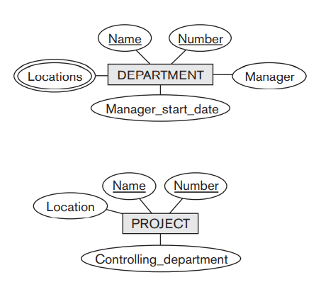
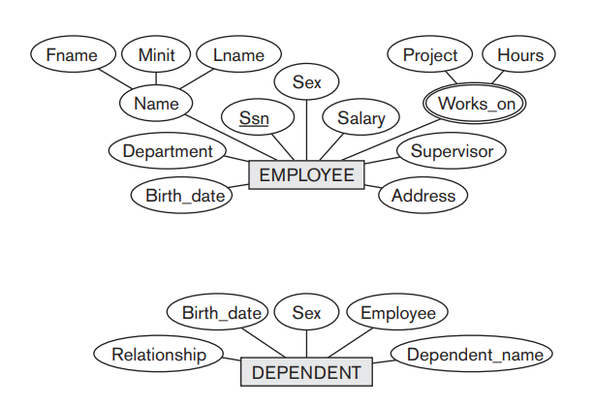

Slide 5
Relationship
When attribute of one entity type refers to another entity type, some relationship exists.
Manager is an employee
Employee has a dependent etc.
An entity type defines a collection (or set) of entities that have the same attributes (same as entity set)
Each of the entity set participates in a relationship
Each relationship instance ri in R is an association of entities, where the association includes exactly one entity from each participating entity type.
Example: WORKS_FOR between EMPLOYEE and DEPARTMENT

Slide 6
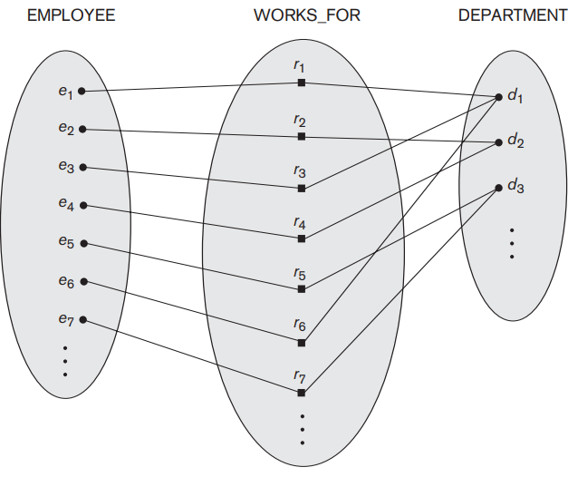

Slide 7
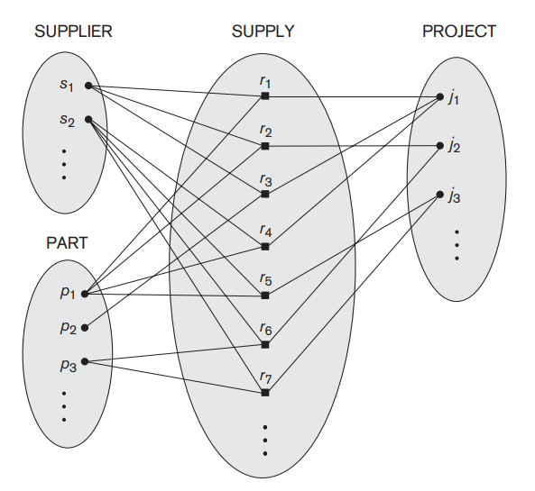
Degree of Relationship
The degree of a relationship type is the number of participating entity types.
Degree of WORKS_FOR: 2 (Binary)
Degree of SUPPLY: 3 (Ternary)
Can you give example of Unary?

Slide 8
Relationship as Attributes
Example: WORKS_FOR relationship type

Slide 9
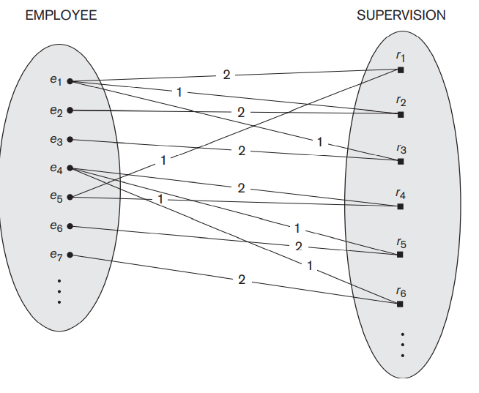
Role and Recursive Relationships
Role: The role of a participating entity in each relationship instance – explains what relation means
Recursive:
The same entity type participates more than once in a relationship type in different roles
SUPERVISION: EMPLOYEE is supervised by SUPERVISOR (Employee)
1 supervisor, 2 supervisee

Slide 10
Constraints on Binary Relationship Types
Limits the possible combinations of entities that may participate in the corresponding relationship
Example: An employee can have 1 supervisor only
Type of Constraints in BR:
Cardinality ratio
. The cardinality ratio for a binary relationship specifies the maximum number of relationship instances that an entity can participate in. Example: DEPARTMENT and EMPLOYEE has cardinality ratio of 1:N. It can also be values like 4 or 5
Participation
The participation constraint specifies whether the existence of an entity depends on its being related to another entity via the relationship type
This constraint specifies the minimum number of relationship instances that each entity can participate in, and is sometimes called the minimum cardinality constraint.

Slide 11

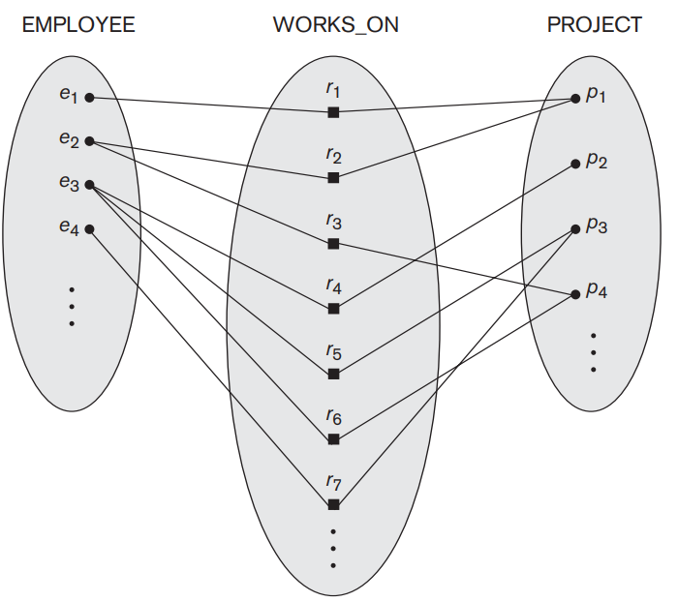
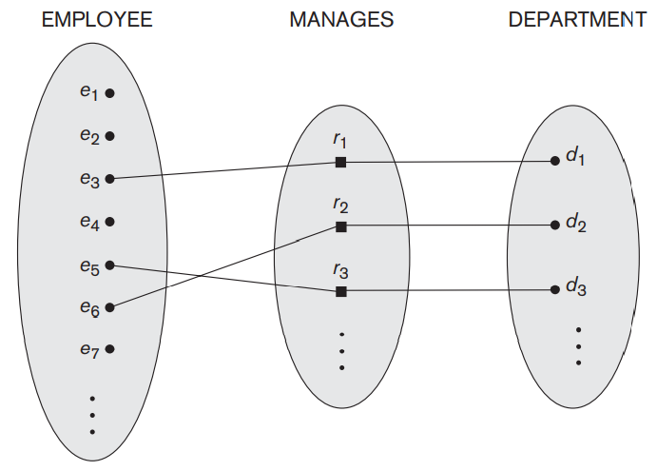
Cardinality/ Multiplicity of E/R Relationships
One-to-one:
1
2
3
a
b
c
d
1
2
3
a
b
c
d
Many-to-one:
1
2
3
a
b
c
d
One-to-many:
Many-to-many:
1
2
3
a
b
c
d

Slide 12
Participation Types/Structural Constraints
Total/Existence Dependency
Every employee must work for a department
Employer participates in at least one WORKS_FOR relationship
Every entity must relate to the other entity via a relationship
Minimum 1: Total participation
Representation: Double Lines
Partial
Some or part of the set of entities are related to the other entity via relationship
Each employee does not manage a department
EMPLOYEE in the MANAGES relationship
Minimum 0: Partial Participation
Representation: Single Line

Slide 13
Weak and Strong Entity Type
Weak:
No key
Entities belonging to a weak entity type are identified by being related to specific entities from another entity type in combination with one of their attribute values. We call this other entity type the identifying or owner entity type, 10 and we call the relationship type that relates a weak entity type to its owner the identifying relationship of the weak entity type. (Parent Entity Type or Dominant Entity Type and Child Entity Type or the Subordinate Entity Type)
Always has a total participation constraint (existence dependency) w.r.t to identifying relationship
Is every existence dependence results in a weak entity type? No?
It sometimes has a partial key/discriminator (underlined with a dashed or dotted line)
Representation: double line diamonds and boxes
Strong:
Has Key
Notes:
DRIVER LICENSE

Slide 14
Naming Conventions
Entity names: Singular/UPPERCASE and Nouns
Relationship Type: UPPERCASE and Verbs
Attribute Names: Initial Letter Capital and Additional Nouns
Role Names: LOWER
Readability: Left to Right and Top to Bottom

Slide 15
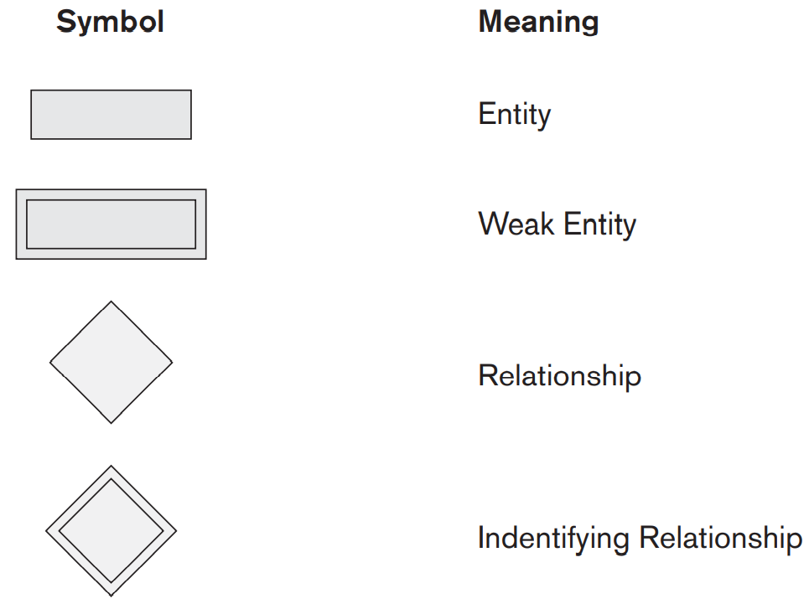
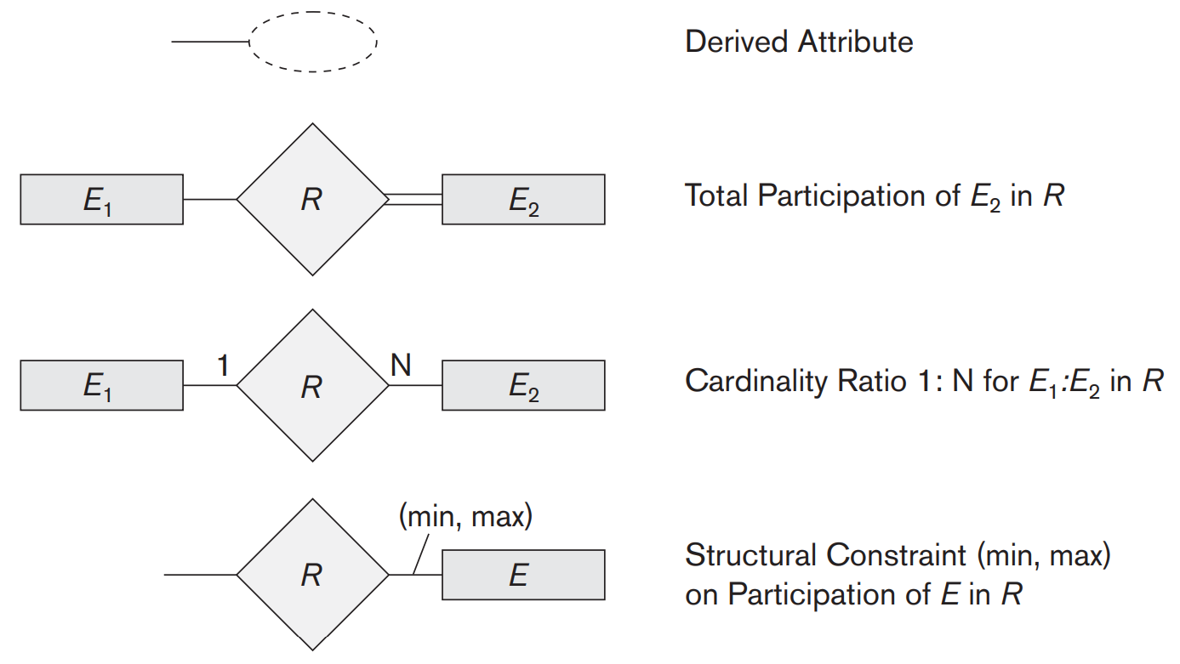
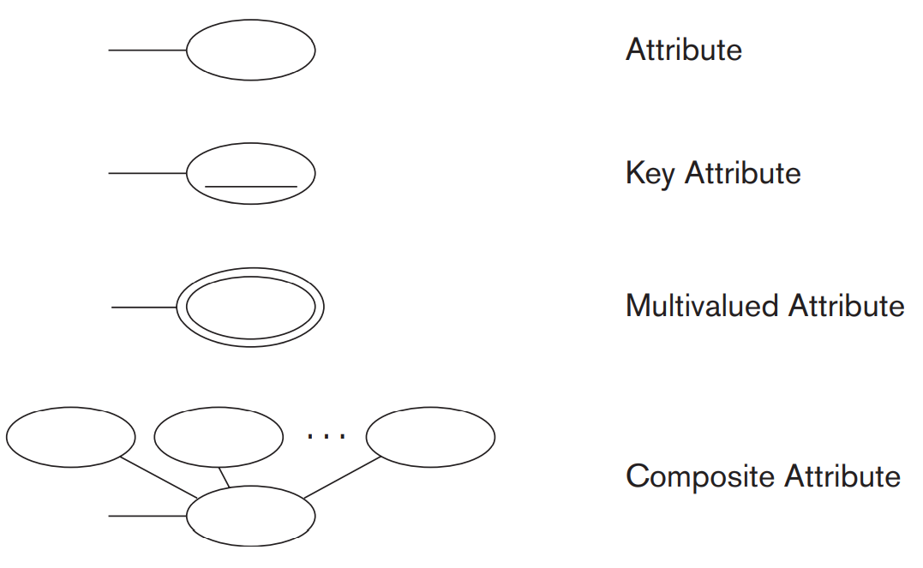

Slide 16
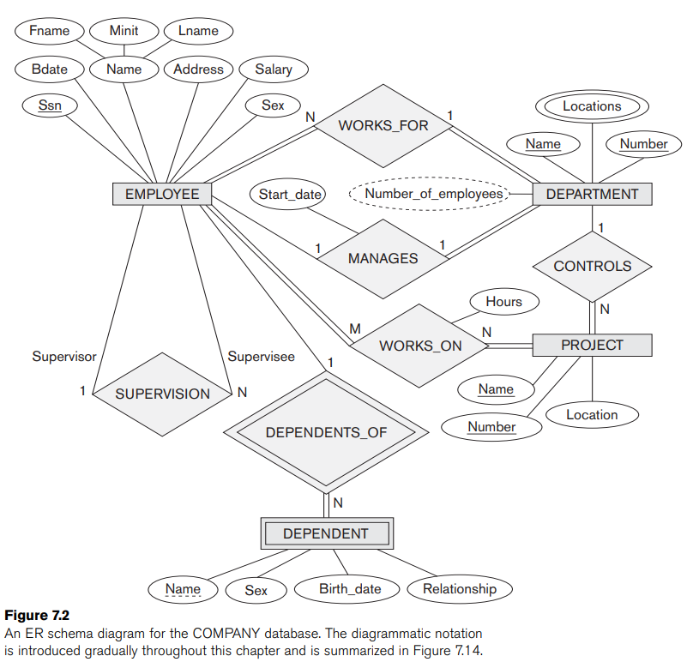

Slide 18
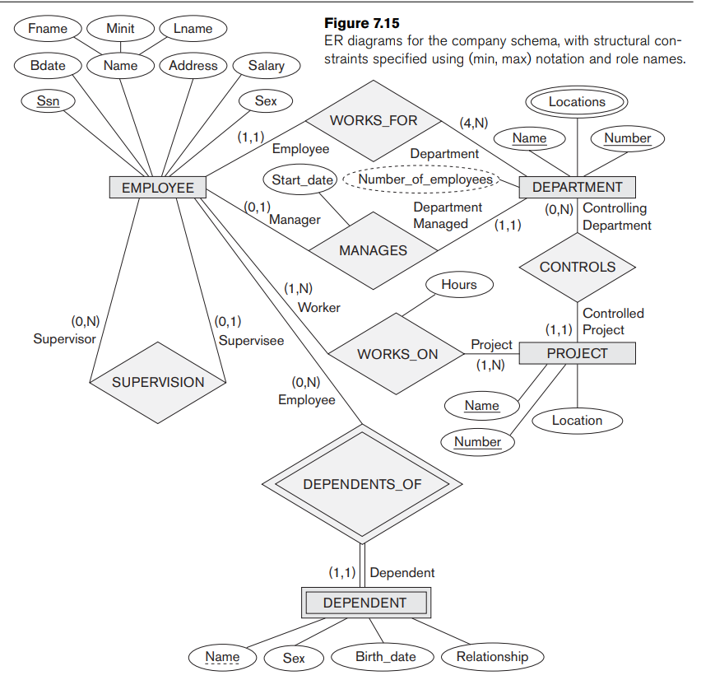

Slide 19
UML Class Diagrams

Slide 20
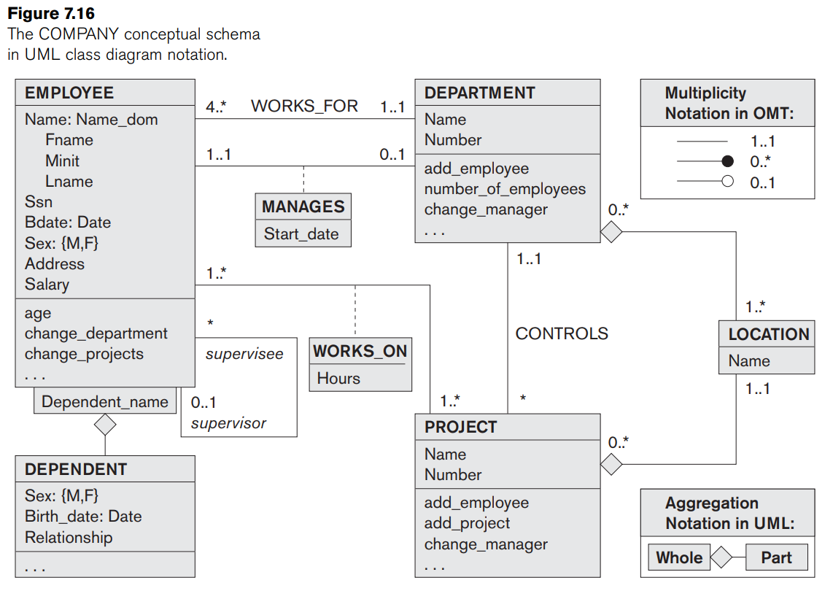
Big Rectangles:
Class Name
Attribute
Operations
Composite Attributes
Structured Domain
Multivalued
As relation
Relationship
Links
Binary links can have names
Relationship Attribute
Link Attribute
Dashed Lines
Constraints
Multiplicities
Min, max and *
Placed on opposite ends
Single * = 0..*
Single 1 = 1..1
Recursive Relationship
Reflexive Association
Relationships
Aggregation and Association

Slide 21
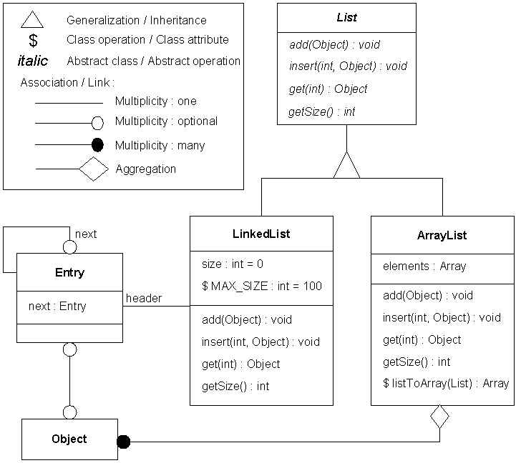

Slide 22

name
category
name
price
makes
Company
Product
stockprice
buys
What does this say?
employs
Person
address
name
ssn
Notes:
a person may be employed by at most one company
a product may be made by at most one company

Slide 23
Multi-way Relationships
How do we model a purchase relationship between buyers,
products and stores?
Product
Purchase
Store
Person
Need to identify purchases by all three keys
Notes:
need to identify purchases by all three keys

Slide 24
Arrows in Multiway Relationships
Q: What does the arrow mean ?
Product
Purchase
Store
Person
Given a person, can determine what they bought and the store where they bought it
Notes:
given a person, can determine what they bought and the store where they bought it

Slide 25
Arrows in Multiway Relationships
Q: What does the arrow mean ?
Product
Purchase
Store
Person
Given a store, can determine who shopped there and the product they bought
each store sells one product and to one person, ever
Notes:
given a store, can determine who shopped there and the product they bought
each store sells one product and to one person, ever

Slide 26
Arrows in Multiway Relationships
Q: How do we say that every person shops in at most one store ?
Product
Purchase
Store
Person
A: Cannot. This is the best approximation. (Why only approximation ?)
Notes:
our representation is not complete! trade-off between complexity and abstraction

